Slide 1
MICROCOMPUTER ARCHITECTURE

Slide 2

Basic Blocks of a Microcomputer
Typical Microcomputer Architecture
Single-Chip Microprocessor
Program Execution by Conventional Microprocessors
Program Execution by typical 32-bit Microprocessors
Scalar and Superscalar Microprocessors
RISC vs. CISC

Slide 3

A microcomputer has three basic blocks: a central processing unit (CPU), a memory unit,
and an input/output (I/O) unit.
The CPU(microprocessor) executes all the instructions and performs arithmetic and logic operations on data.
A memory unit stores both data and instructions. The memory section typically
contains ROM and RAM chips.
A system bus (comprised of several wires) connects these blocks.

Slide 4

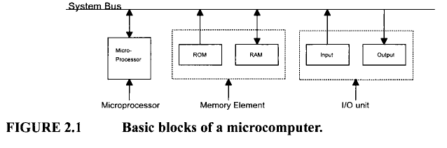

Slide 5
In a single-chip microcomputer, these three elements are on one chip, whereas
in a single-chip microprocessor, separate chips are required for memory and I/O.

Slide 6

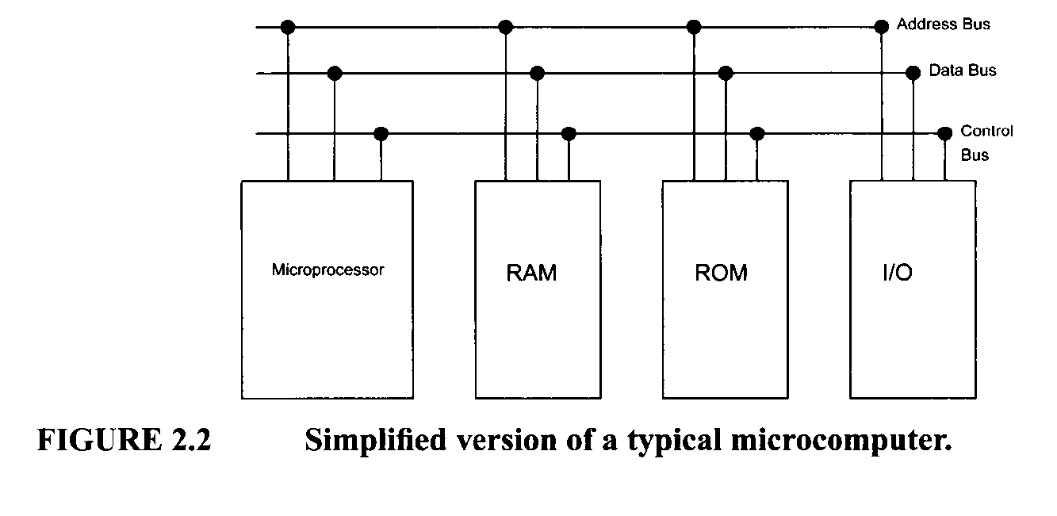

Slide 7

The microcomputer’s system bus contains three buses, address, data, and control bus
When a memory or an I/O chip receives data from the microprocessor, it is called a WRITE operation, and data is written into a selected memory location or an I/O port (register).
When a memory or an I/O chip sends data to the microprocessor, it is called a READ operation, and data is read from a selected memory location or an I/O port.

Slide 8

The Address Bus
Unidirectional bus: Information transfer takes place in only one direction, from the microprocessor to the memory or I/O elements.
Typically 20 to 32 bits long.
The size of the address bus determines the
total number of memory addresses available
For example : microprocessor with 32 address pins can
generate 2³² = 4,294,964,296 bytes

Slide 9
The data bus,
bidirectional bus: data can flow in both directions, that is, to or from the microprocessor.
The size of the data bus varies from one microprocessor to another.

Slide 10
The control bus
consists of a number of signals that are used to synchronize operation of the individual microcomputer elements.
Is it Unidirectional or bidirectional bus ??

Slide 11

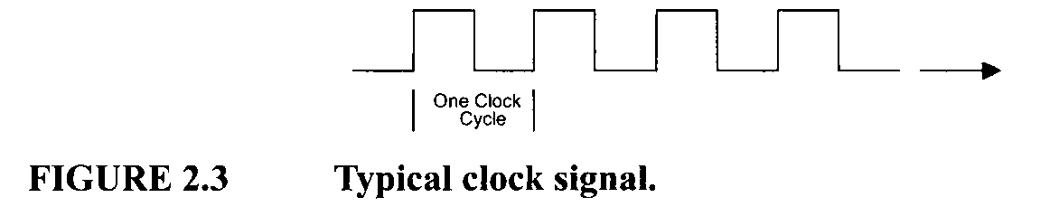
The system clock signals are contained in the control bus.
The number of cycles per second (hertz, abbreviated Hz) is referred to as the clock frequency.
clock cycle = 1/f where f is the clock frequency.
clock frequency determines the speed of the microcomputer.

Slide 12

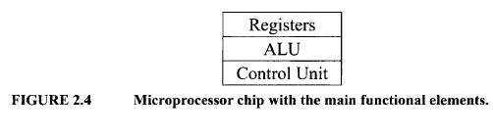
The microprocessor is the CPU of the microcomputer
The logic inside the microprocessor chip can be divided into three main areas: the
register section, the control unit, and the arithmetic-logic unit (ALU).

Slide 13

The number, size, and types of registers vary from one microprocessor to another.
Basic Microprocessor Registers There are four basic microprocessor registers: instruction register, program counter, memory address register, and accumulator.

Slide 14
Instruction register (IR) :
The instruction register stores instructions.
The word size of the microprocessor determines the size of the instruction register. For example, a 32-bit microprocessor has a 32-bit instruction register.

Slide 15
Program Counter (PC):
The program counter contains the address of the instruction or operation code (op-code).
The program counter normally contains the address of the next instruction to be executed.
The size of the program counter is determined by the size of the address bus.

Slide 16

How Program Counter is Work ?
Upon activating the microprocessor’s RESET input, the address of the first instruction to be executed is loaded into the program counter.
To execute an instruction, the microprocessor typically places the contents of the program counter on the address bus and reads (“fetches”) the contents of this address(i.e., instruction) from memory
The program counter contents are incremented automatically by the microprocessor’s internal logic. Microprocessor executes a program sequentially, unless the program contains an instruction such as a JUMP instruction, which changes the sequence.

Slide 17
Memory Address Register (MAR).
The memory address register contains the address of data. The microprocessor uses the address, which is stored in the memory address register, as a direct pointer to memory. The contents of the address is the actual data that is being transferred.

Slide 18
General Purpose Register (GPR). For an 8-bit microprocessor, the general-purpose register is called the accumulator.
It stores the result after most ALU operations.
These 8-bit microprocessors have instructions to shift or rotate the accumulator one bit to the right or left through the carry flag.
In16- and 32-bit microprocessors the accumulator is replaced by a GPR.
any GPR can be used as an accumulator.

Slide 19
General Purpose Register (GPR).
The term general-purpose comes from the fact that these registers can hold data, memory
addresses, or the results of arithmetic or logic operations.
Most registers are general-purpose, but some, such as the program counter (PC),are provided for dedicated functions.

Slide 20
Other Microprocessor Registers such as general-purpose registers, index register, status register and stack pointer register.
general-purpose registers speeds up the execution of a program because the microprocessor does not have to read data from external memory via the data bus if data is stored in one of its general-purpose registers.
Index Register is typically used as a counter in address modification for an instruction or for general storage functions. Used to access tables or arrays of data.
Status Register( a processor status word register or condition code register, contains individual bits, with each bit having special significance. The bits in the status register are called flags.

Slide 21
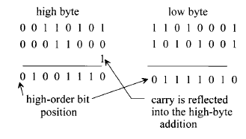
Flags Type
A carry flag is used to reflect whether or not the result generated by an arithmetic operation is greater than the microprocessor’s word size.
Auxiliary carry flag

Slide 22
Flags Type
A zero flag is used to show whether the result of an operation is zero. It is set to1 if the result is zero, and it is reset to 0 if the result is nonzero.
A parity flag is set to 1 to indicate whether the result of the last operation contains either an even number of 1’s (even parity) or an odd number of 1’s (odd parity), depending on the microprocessor.

Slide 23
Flags Type
A sign flag (sometimes called a negative flag) is used to indicate whether the result of the last operation is positive(set to 0) or negative(set to 1)
Overflow flag arises from representation of the sign flag by the most significant bit of a word in signed binary operation. The overflow flag is set to1 if the result of an arithmetic operation is too big for the microprocessor’s maximum word size, otherwise it is reset to 0

Slide 24
EXAMPLE :
Find the sign,carry,zero,overflow,and parity even flag for the following arithmetic sign number:
(11110000)+(10100001) =10010001
SF =1 ,CF=1 ,ZF=0 ,OF=0 ,PF=0

Slide 25
Stack Pointer Register A stack consists of a number of RAM locations set aside for reading data from or writing data into these locations and is typically used by subroutines
Two instructions, PUSH and POP, are usually available with a stack. The PUSH operation
is defined as writing to the top or bottom of the stack, whereas the POP operation means reading from the top or bottom of the stack.

Slide 26
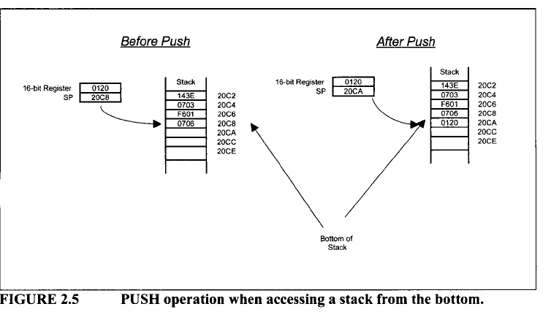

Slide 27
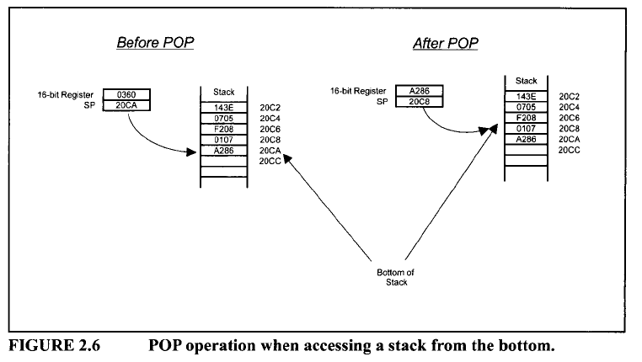

Slide 28
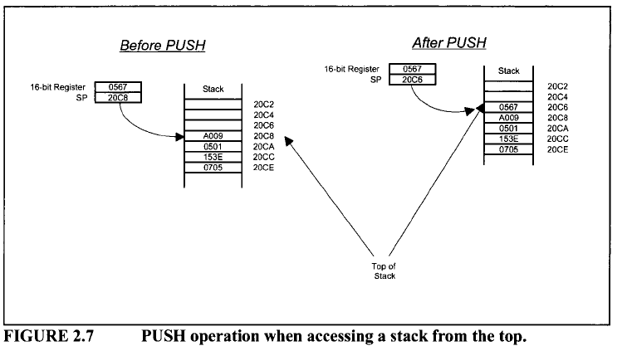

Slide 29
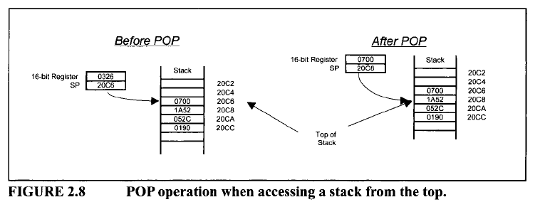

Slide 30

The main purpose of the control unit is to read and decode instructions from the program memory.
To execute an instruction, the control unit steps through the appropriate blocks of the ALU based on the op-codes contained in the instruction register.

Slide 31

Control Signal Actions
RESET. This input is common to all microprocessors. When this input pin is driven HIGH or LOW (depending on the microprocessor), the program counter is loaded with a predefined address specified by the manufacturer.

Slide 32
Control Signal Actions
READ/WRITE (R/W) This output line is common to all microprocessors. The status of this line tells the other microcomputer elements whether the microprocessor is performing a READ or a WRITE operation. A HIGH signal on this line indicates a READ operation, and a LOW indicates a WRITE operation.

Slide 33
Control Signal Actions
READY, This is an input to a microprocessor. Slow devices (memory and I/O) use this signal to gain extra time to transfer data to or receive data from a microprocessor. The READY signal is usually an active low signal; that is, LOW indicates that the microprocessor is ready. Therefore, when the microprocessor selects a slow device, the device places a LOW on the READY pin. The microprocessor responds by suspending all its internal operations and enters a WAIT state. When the device is ready to send or receive data, it removes the READY signal. The microprocessor comes out of the WAIT state and performs the appropriate operation.

Slide 34
Control Signal Actions
Interrupt Request (INT or IRQ). The external I/O devices can interrupt the microprocessor via this input pin on the microprocessor chip. When this signal is activated by the external devices, the microprocessor jumps to a special program called the interrupt service routine. This program is normally written by the user for performing tasks that the interrupting device wants the microprocessor to carry out. After completing this program, the microprocessor returns to the main program it was executing when the interrupt occurred.

Slide 35

The ALU performs all the data manipulations, such as arithmetic and logic operations, inside a microprocessor. The size of the ALU conforms to the word length of the microcomputer.
ALU Functions:
1.Binary addition and logic operations
2. Finding the one’s complement of data
3. Shifting or rotating the contents of a general-purpose register 1 bit to the left or right through a carry

Slide 36

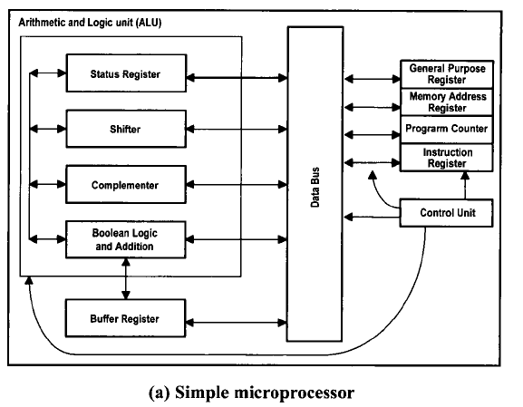
Simple Microprocessor

Slide 37
Buffer Register : Stores any data read from memory for further processing by the ALU.

Slide 38
Typical Microprocessor

Slide 39
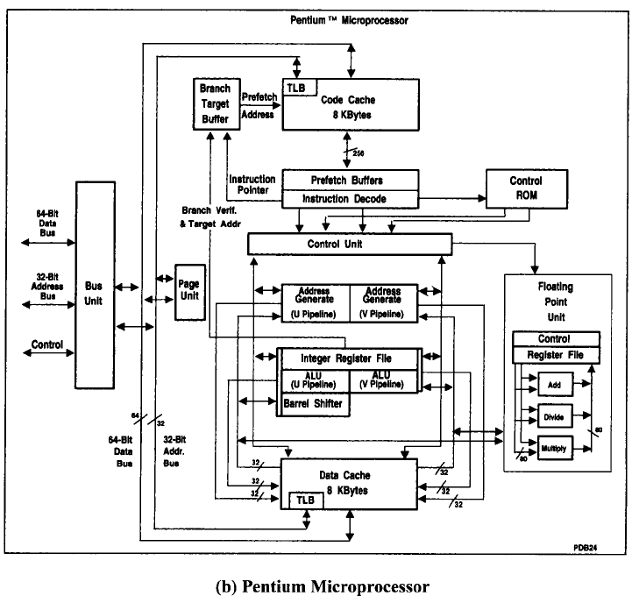

Slide 40
The Pentium contains two instruction pipelines: the U-pipe and the V-pipe. The U-pipe can execute all integer and floating-point instructions. The V-pipe can execute simple integer instructions
The Pentium contains two separate cache memories: code cache and data cache.

Slide 41
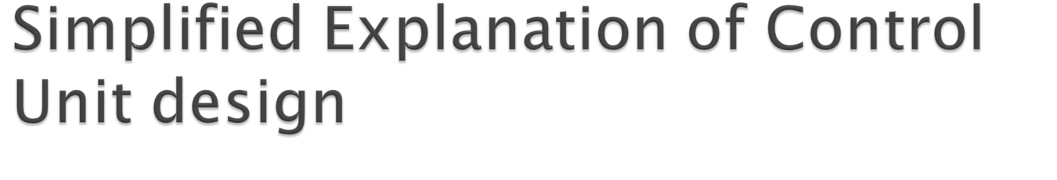
The control unit performs two basic operations:
instruction interpretation
and instruction sequencing.

Slide 42
There are two methods for designing a control unit:
hardwired control | Microprogrammed control(firmware)
clocked sequential circuit. | ROM inside the control unit (control memory) more expensive flexibility

Slide 43
How incrementing the contents of the register by 1 is done in microprogramming
control ??
(see figures in next slides)

Slide 44
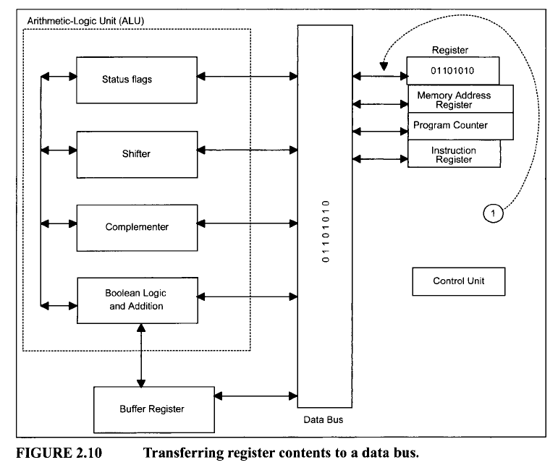

Slide 45
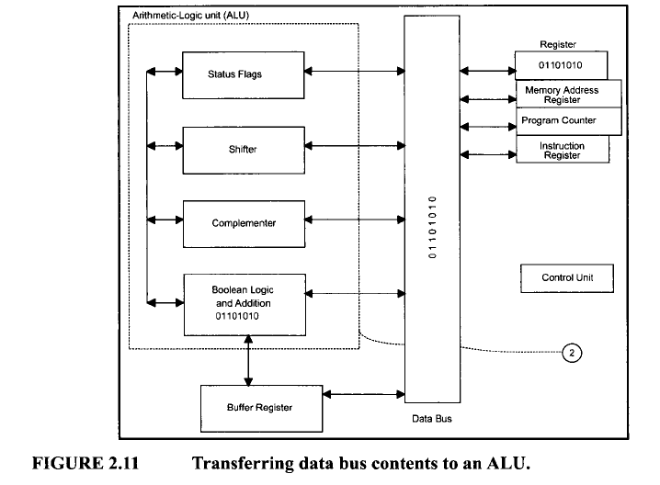

Slide 46
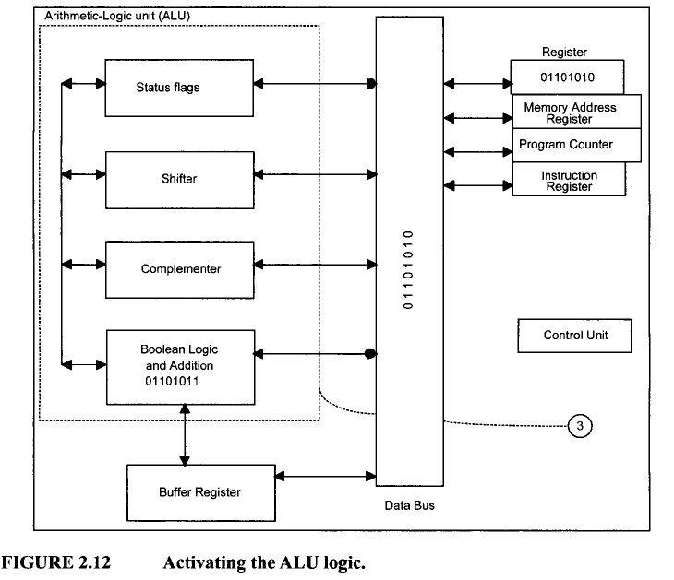

Slide 47
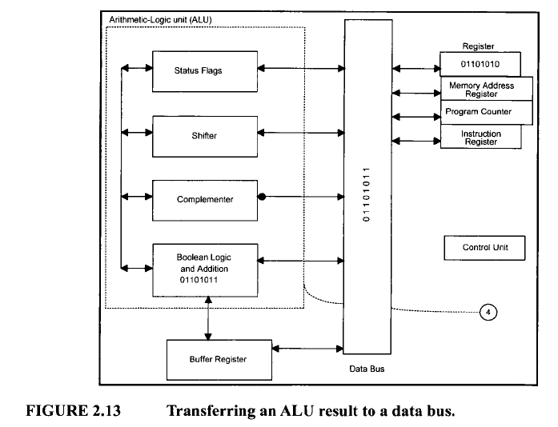

Slide 48
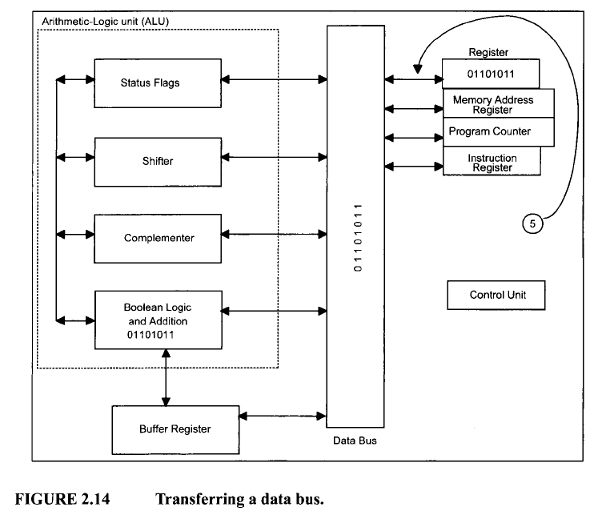

Slide 49

The following three steps for completing the instruction:
1.Fetch. The microprocessor fetches (instruction read) the instruction from the main memory (external to the microprocessor) into the instruction register.
2. Decode. The microprocessor decodes or translates the instruction using the control unit. The control unit inputs the contents of the instruction register, and then decodes (translates) the instruction to determine the instruction type.
3. Execute. The microprocessor executes the instruction using the control unit. To accomplish the task, the control unit generates a number of enable signals required by the instruction.

Slide 50

For example, suppose that it is desired to add the contents of two registers, X and Y, and store the result in register Z. To accomplish this, a conventional microprocessor performs the following steps:
1. The microprocessor fetches the instruction into the instruction register.
2. The control unit (CU) decodes the contents of the instruction register.
3. The CU executes the instruction by generating enable signals for the register and ALU sections to perform the following:
a. The CU transfers the contents of registers X and Y from the Register section into the ALU.
b. The CU commands the ALU to ADD.
c. The CU transfers the result from the ALU into register Z of the register section.

Slide 51
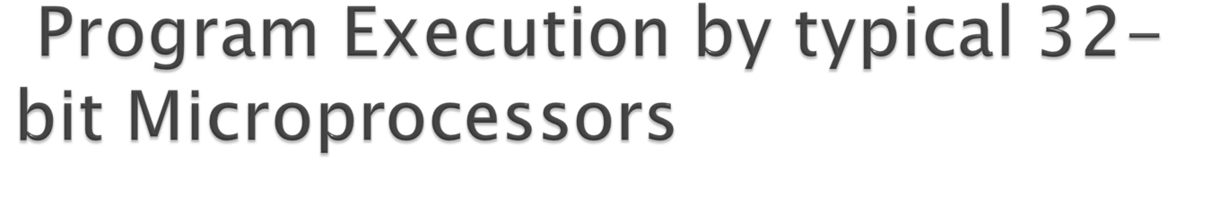
Enhancement in 32-bit microprocessors (like Pentium) include : cache memory, memory
management, pipelining, floating-point arithmetic, and branch prediction.
Cache memory is a high-speed read/write memory implemented as on-chip
hardware in typical 32-bit microprocessors in order to increase processing rates.

Slide 52
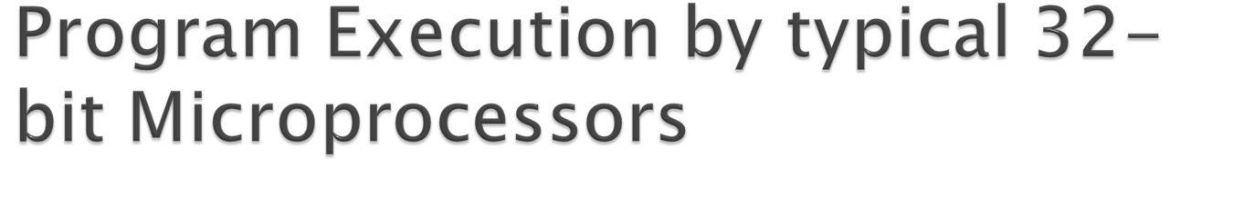
Memory management allows programmers to write programs much larger than those that could fit in the main memory space available to the microprocessors; the programs are simply stored on a secondary device, such as a hard disk.

Slide 53

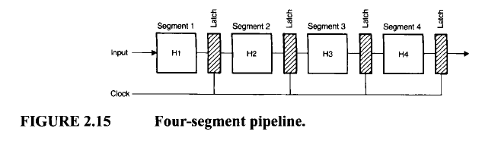
Basic Concept
Hi is Hardware designed to perform activity Ai

Slide 54

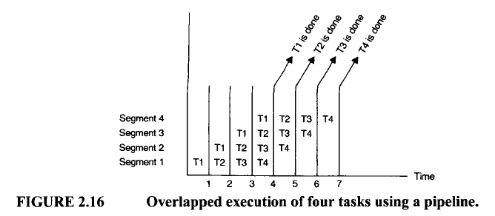

Slide 55
Two Kind of Pipelining:
Arithmetic operations and instruction execution.

Slide 56
Arithmetic Pipelines
Consider the process of adding two floating-point numbers x =0.9234 * 10⁴ and y = 0.48 * 10 ².
First: exponents of x and y are unequal.
Second: exponent alignment.
Third: Perform the addition
Fourth: Normalize the final answer

Slide 57
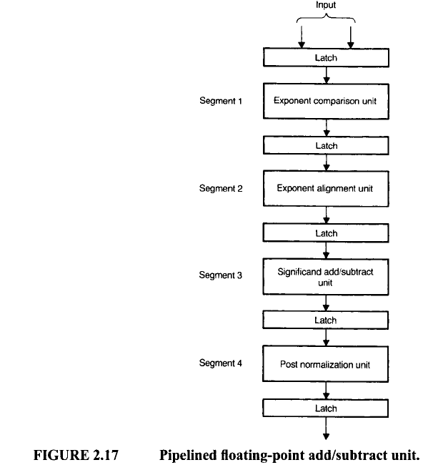

Slide 58
Instruction Pipelines
Instruction cycle typically involves the
following activities:
1. Instruction fetch -→needs five clocks to complete
2. Instruction decode
3. Operand fetch (Data Read)
4. Operation execution
5. Result routing.

Slide 59
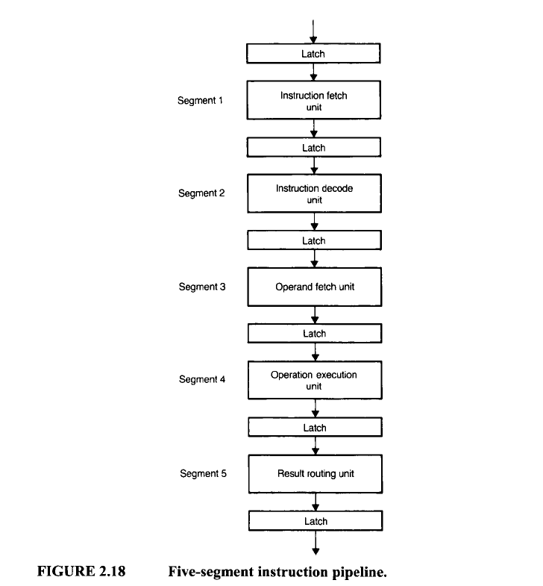

Slide 60
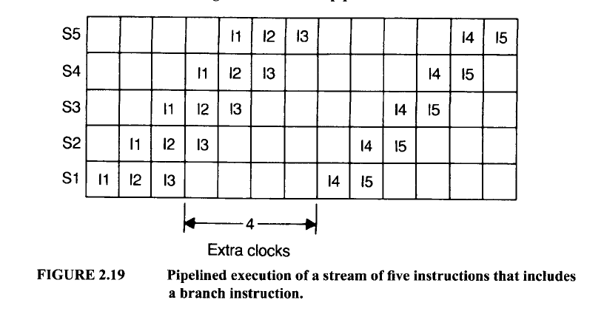
Example of the execution of a stream of five instructions: 11,12,13,14, and 15, in which I3 is a conditional branch instruction.

Slide 61

This allows these microprocessors to anticipate jumps of the instruction flow ahead of time.

Slide 62
To accomplish this, the Pentium includes on-chip hardware called the Branch Unit (BU). The BU contains the branch execution unit (BEU) and the branch prediction unit (BPU). Whenever the Pentium encounters a conditional branch instruction, it sends it to the BU for execution. The BU evaluates the instruction’s branch condition using the BEU and determines whether the branch should or should not be taken. Once the BU determines the branch condition, it calculates the starting address (Branch target) of the next block of code to be executed. The Pentium then starts fetching code at the new address.

Slide 63

Scalar processors such as the 80486 can execute one instruction per cycle.
The 80486 contains only one pipeline.
Superscalar microprocessors, can execute
more than one instruction per cycle. These microprocessors contain more than one pipeline.
The Pentium, a superscalar microprocessor, contains two independent pipelines. This
allows the Pentium to execute two instructions per cycle.

Slide 64

There are two types of microprocessor architectures: RISC and CISC.
RISC stand for (reduced instruction set computer) and CISC for (complex instruction set computer)

Slide 65

CISC | RISC
large number of instructions and many addressing modes | a simple instruction set with a few addressing modes
slower clock rate | fast clock rate
complex control unit, thus requiring microprogrammed implementation. | hardwired control Unit
more difficult to pipeline; | more efficient pipelining.
complex programs require fewer instructions in CISC | RISC requires a large number of instructions to accomplish the same task

Slide 66

Intel’s original Pentium is a CISC microprocessor. Intel Pentium Pro and other succeeding members of the Pentium family and Motorola 68060 use a combination of RISC and CISC architectures for providing high performance. The Pentium Pro and other succeeding

